Slide 1




Marketing Campaign Data Analysis using Excel
STUDENT NAME:T.SUJITHA
REGISTER NO:422200045
DEPARTMENT:B.COM(ISM)
COLLEGE:S.I.V.E.T COLLEGE

Slide 2

Marketing Campaign Data Analysis Using Excel

Slide 3


AGENDA
Problem Statement
Project Overview
End Users
Our Solution and Proposition
Dataset Description
Modelling Approach
Results and Discussion
Conclusion
3/21/2024 Annual Review

Slide 4

PROBLEM STATEMENT
Problem statement
A problem statement for a marketing campaign is a clear and concise description of the issue or problem that need to be addressed, and how it
Should be addressed.
The chief marketing officer that recent marketing campaigns have not
Been as effective as they were expected to be and the conversion rate is very low.
Task is to analyse the related data, understand the problem, and identify key
Insights and recommendations or the CMO to potentially implement.
problem statement for a marketing campaign is a clear and concise
Description of the issue

Slide 5

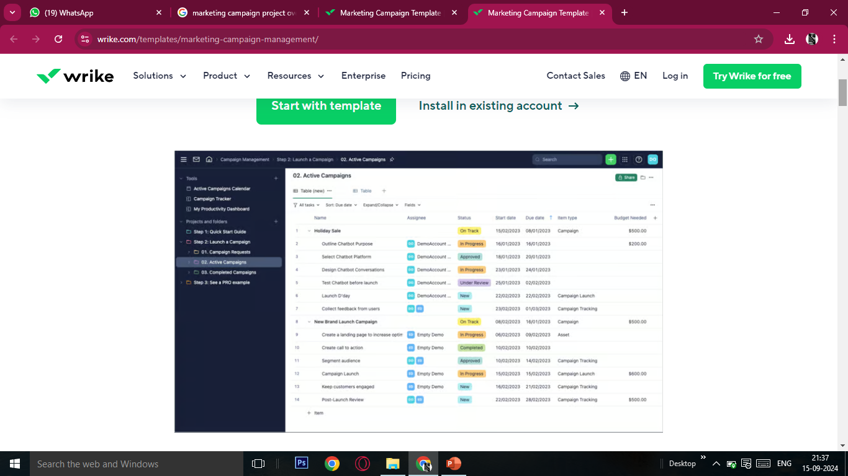
PROJECT OVERVIEW
A Marketing project plan consists of all the research and strategies
Required to successfully carry out a marketing venture. It involves documenting
Business goals current business situation ,target customers, and KPIs to track
Marketing success.
A marketing campaign project plan is a strategic document that helps
Businesses coordinate efforts and optimize resources. It’s important to delegate
tasks to trusted team members so that you can focus on managing the project plan.

Slide 6

WHO ARE THE END USERS?
Definition
End users are the people who purchase and use a product or service, and are also known as the end consumer.
Importance
End users are important to consider throughout the product development process, as their needs and goals should be kept in mind. They can also provide valuable feedback to developers to ensure that the product is useful and functions properly.
Difference from customers
End users are not always the same as customers, as sometimes a customer may be purchasing a product on behalf of someone else. For example, a company may purchase software for their employees to use.

Slide 7

OUR SOLUTION AND ITS VALUE PROPOSITION
A company's value proposition is a statement that explains the benefits of its products or services to its target audience. It's a key part of a company's marketing strategy and helps differentiate the brand in the market.
Here are some tips for writing an effective value proposition:
clear and concise: Focus on the main points and communicate them clearly.
Target your audience: Make sure your message speaks to your target audience.
Focus on benefits: Tell customers what they'll get from your product or service, rather than just the features.
Avoid jargon: Interview customers to learn how they talk about your product, and use that language in your messaging.
Speak directly to your audience: Focus your messaging on the audience's needs, not your own.

Slide 8
Dataset Description
Variables/Features:
Campaign ID (unique identifier)
Campaign Name
Start/End Dates
Marketing Channels (email, social media, search)
Target Audience (demographics, interests)
Ad Content (text, images, videos)

Slide 9

THE "WOW" IN OUR SOLUTION
To create a "wow" factor in a marketing campaign, you can try these strategies:
Make it memorable: Create a memorable experience that stands out and evokes an emotional reaction.
Offer something unexpected: Exceed customer expectations by offering something new or surprising, like a free gift or a new feature.
Make it fun: Create a fun and fulfilling experience by adding a little extra, like music, lighting, or food.
Go above and beyond: Provide great customer support and go above and beyond to show that you care.
Host events: Host events or workshops to create a memorable experience.
Use social media: Use social media to entertain your customers rather than just promote your products.
3/21/2024 Annual Review
9

Slide 10
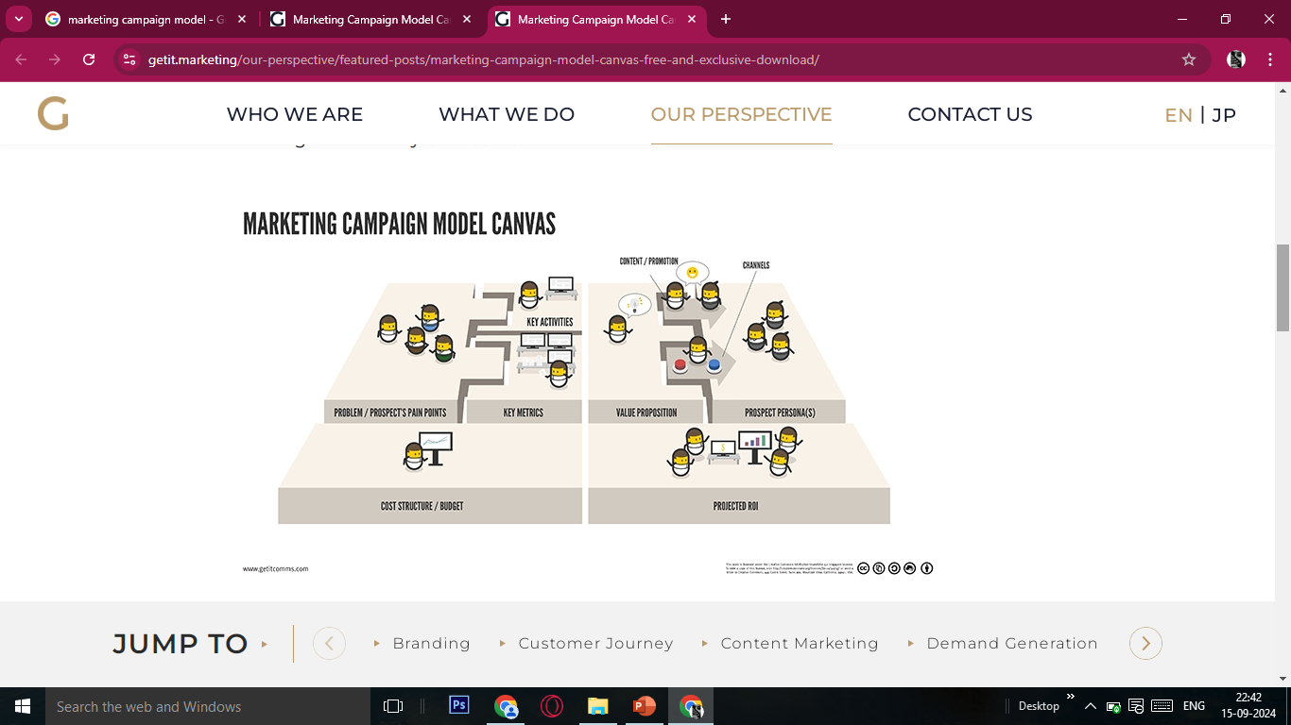
MODELLING
10

Slide 11
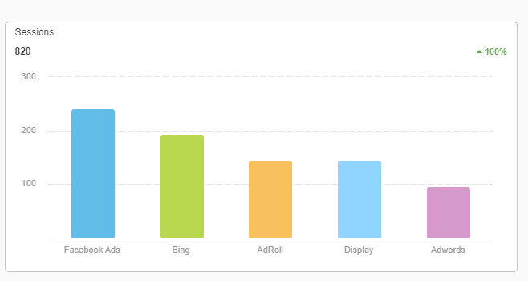
RESULTS
11

Slide 12
Conclusion
The campaign successfully exceeded its goal of increasing online sales by 20%, achieving a 22% rise. Key successes included high engagement with video ads, which saw a 50% higher click-through rate compared to static ads, and positive customer feedback with a 90% satisfaction rate. Challenges included lower-than-expected email engagement and slightly higher CPA in some segments.

